Slide 1
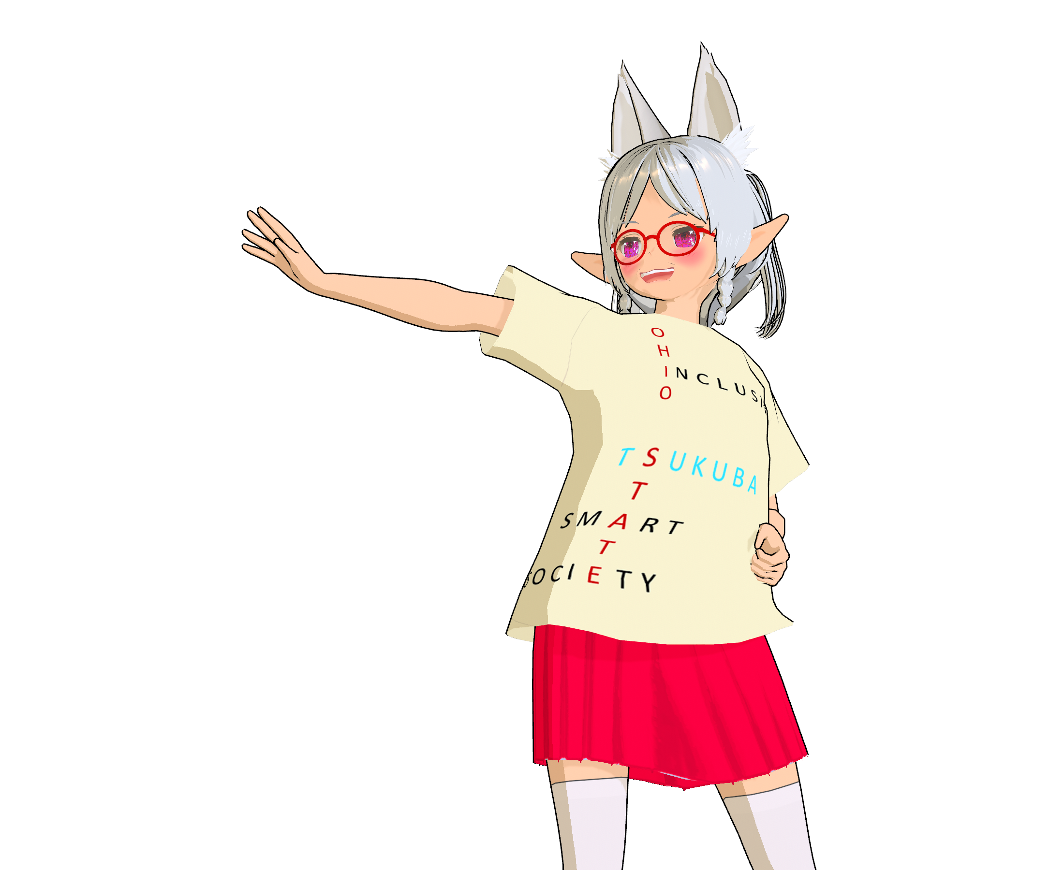
Inclusive smart society for elderly people living alone in rural areas.
ISS Summer Festival 2025
Manga Story Competition

Slide 2
Task: Answer the following 3 Questions.
Q1. What are the issues concerning elderly people living alone in rural society?
Q2. How would you solve that problem, with what kind of technology, system or measure?
Q3. Create a manga story in a three-act structure, set in a society where the chosen problem has been solved, with an elderly person living alone in a rural area as the main character.
The elderly person is not necessarily the protagonist.

Slide 3
Q1. What are the issues concerning elderly people living alone in rural society?
Let's think of as many things as possible.

Slide 4
Q2. How would you solve that problem, with what kind of technology, system or measure?
Describe as concretely as possible, such as images of gadgets.

Slide 5
Q3. Create a manga story in a three-act structure, set in a society where the chosen problem has been solved, with an elderly person living alone in a rural area as the main character.
The elderly person is not necessarily the protagonist.
Act 1 (Set-up): Description of the setting of the story.
Act 2 (Confrontation): Incident or trouble stands in front of the characters. They try to solve.
Act 3 (Resolution): The confrontation between the characters and the problem reaches a climax and is finally resolved.

Slide 6
Settings: When and where does the story take place? How have the problems related to elderly people living alone in rural areas been solved?

Slide 7
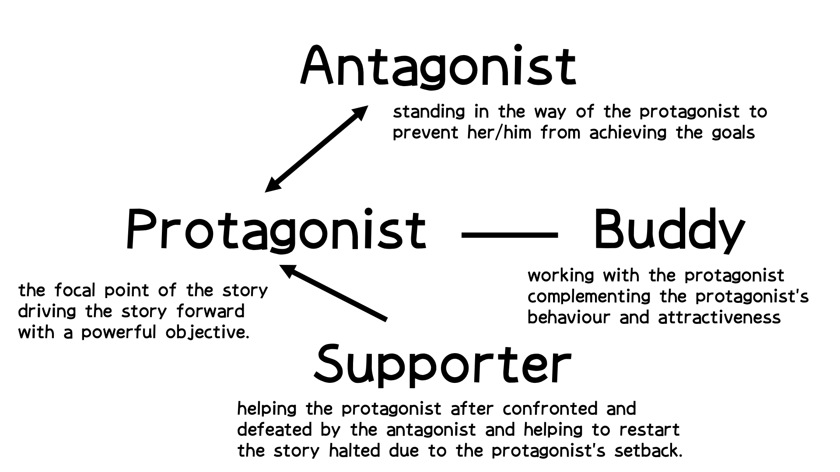
Character settings
Let's think about the characters’ settings concretely.
The role in the story (protagonist, etc.), appearance,
costumes, way of speaking, personality, concerns, worries, values, principles, strengths, weaknesses,
etc.

Slide 8
Q3-1 (Act 1). First, introduce the setting and characters. In a society where issues related to elderly people living alone in rural areas have been resolved, how does the elderly character live? What is the relationship between the elderly character, the protagonist, and the other characters?

Slide 9
Q3-2 (Act 2). It was a peaceful everyday life, but then something happened to the characters, and the protagonist tried to solve it but failed. What happened to whom? What did the protagonist do to solve it? What was the result?

Slide 10
Q3-3 (Act 3). As the issue remains unresolved and the situation worsens, the protagonist makes a decision and takes final action. The story reaches its climax. What actions did the protagonist take? What resulted from their actions? How did the results change the protagonists and other characters?

Slide 11
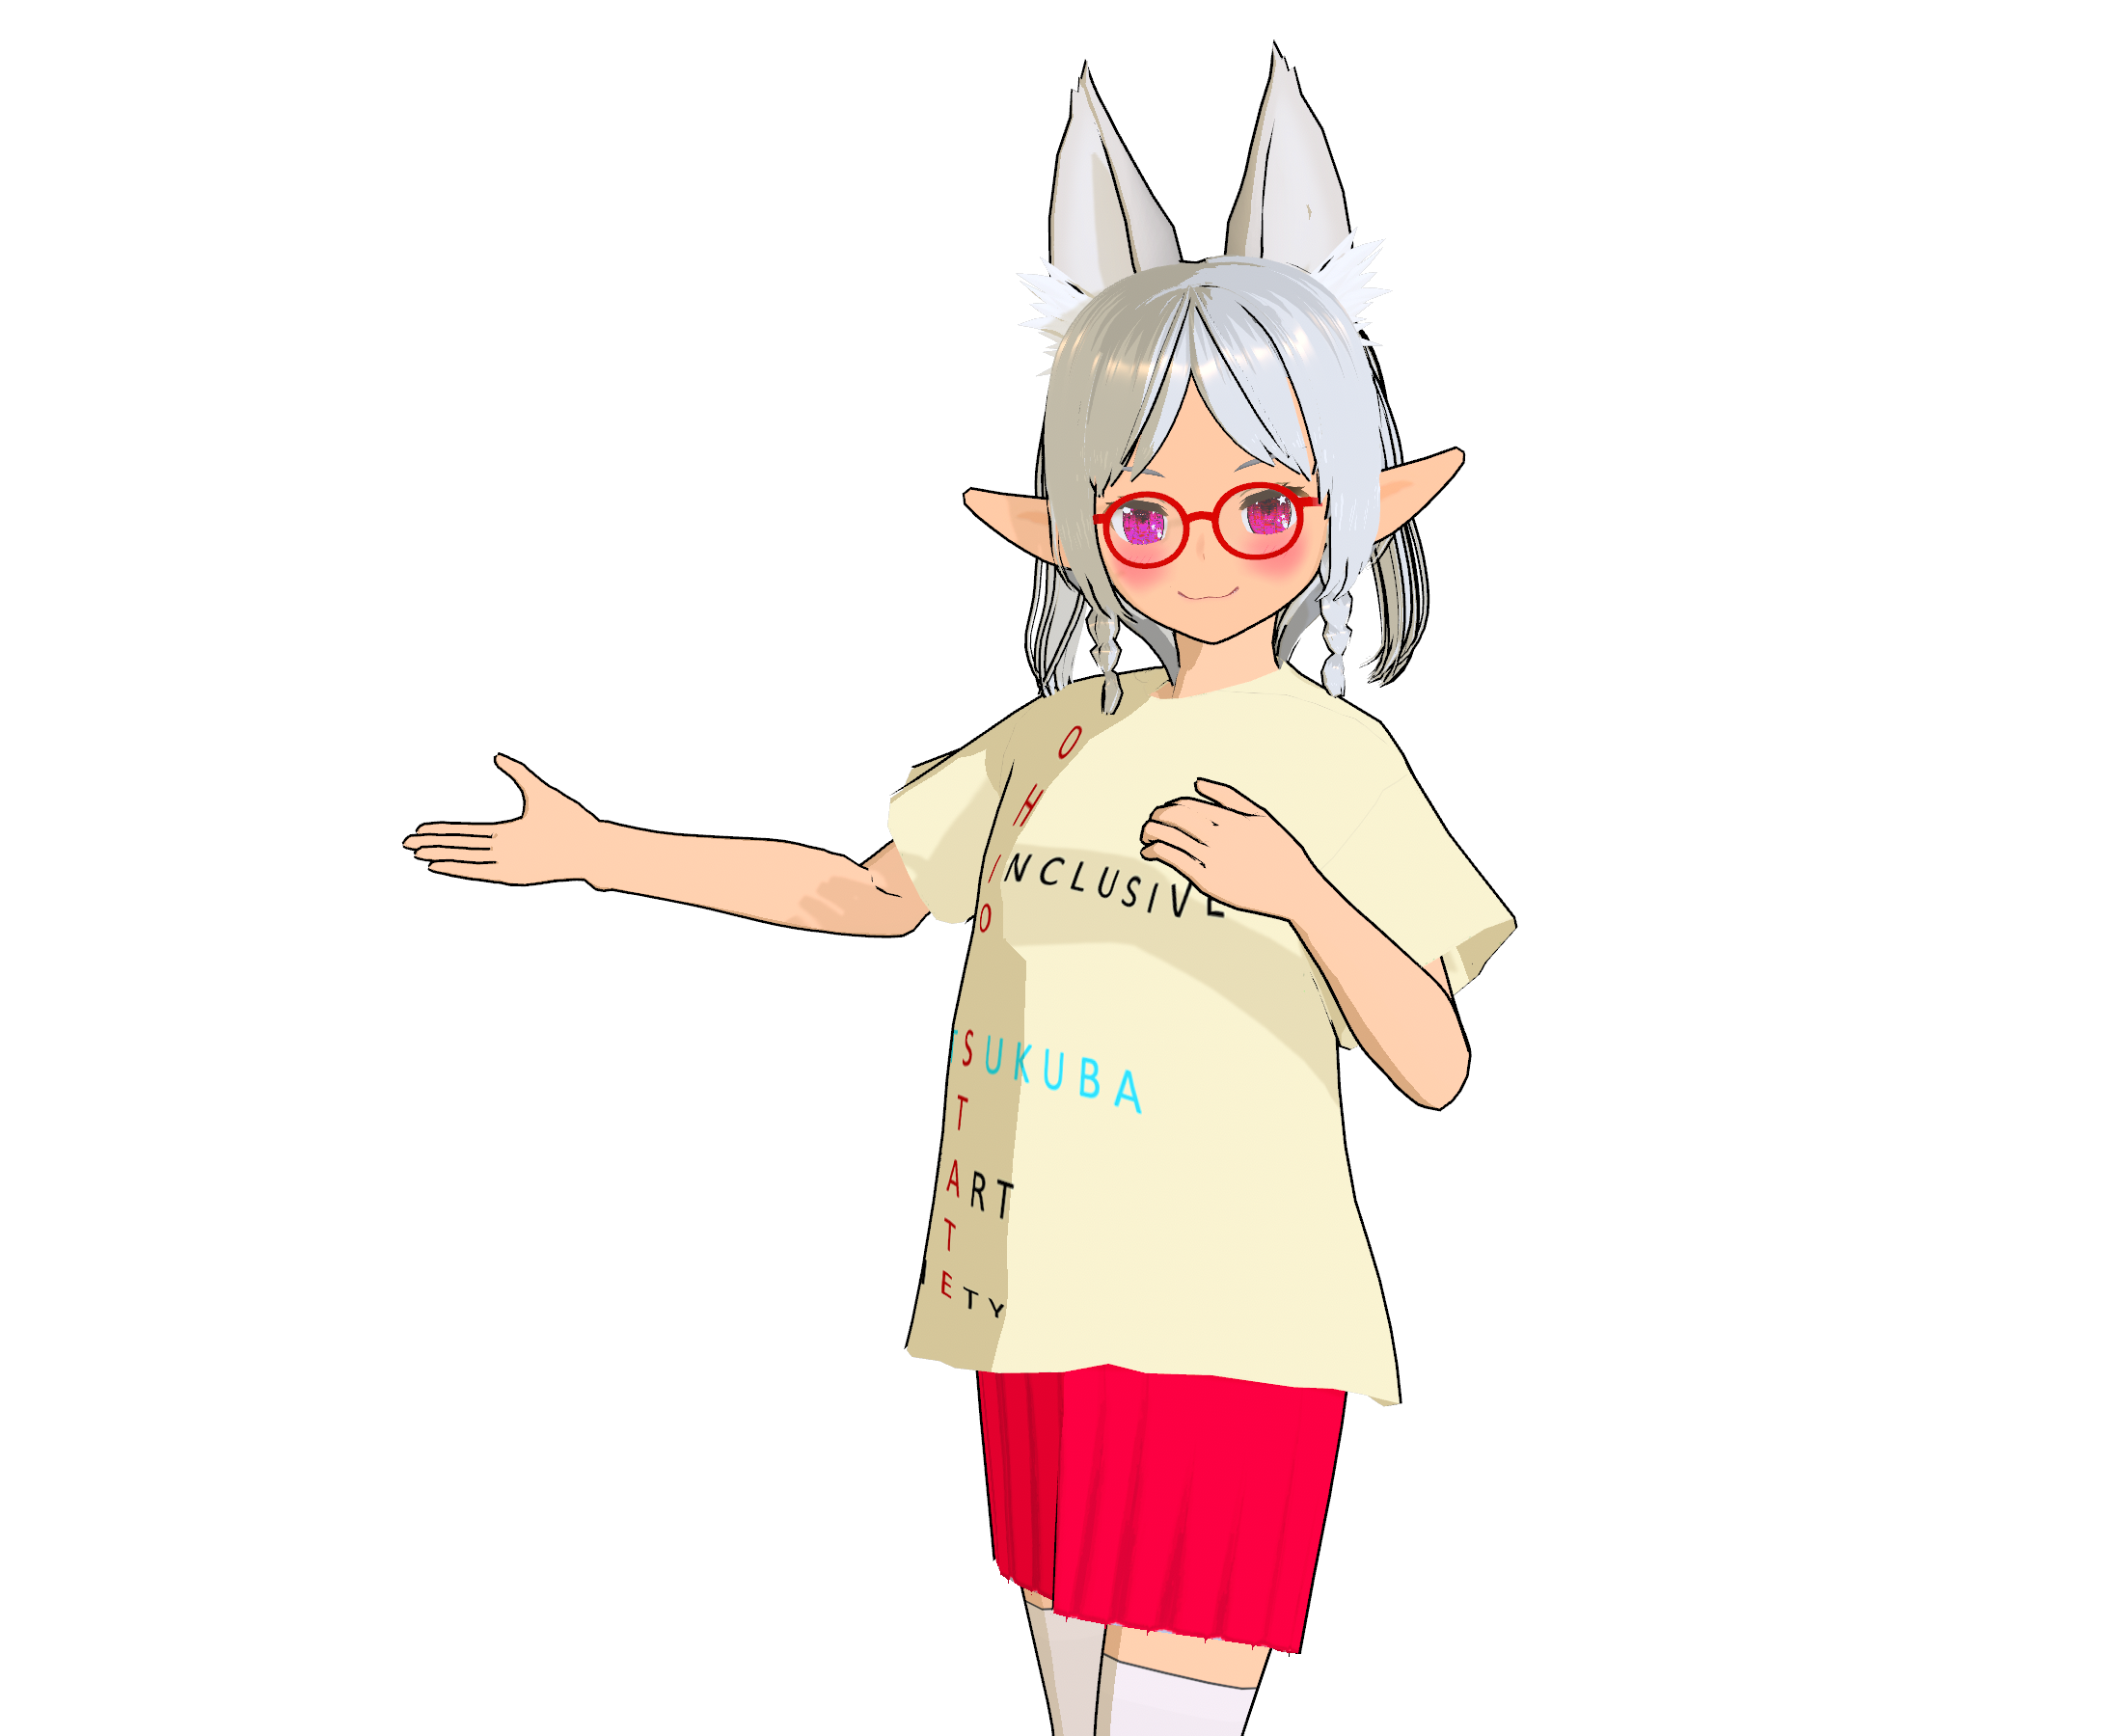
Email your story to the ISS Program Office by 26 June 2025 23:55 (JST). info.tenkai-us@un.tsukuba.ac.jp We look forward to your stories.

